Slide 1

Performance and Prospects for Travel
Adam Sacks
President
Tourism Economics
adam@tourismeconomics.com
May 2019

Slide 2
Let’s pose some questions
Outline | What’s happening now?
 | Where are we headed?
 | What should be done?

Slide 3
What’s happening now?
Notes:
3

Slide 4
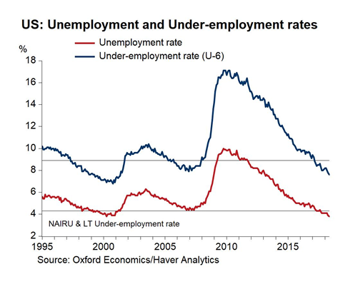
US: unabated travel growth
Flying has increasingly been the mode of choice
2017
2018

Slide 5
Focus on 2018: international is slowing

Slide 6
The last two years have marked a shift

Slide 7
Most major markets have lost visitor purchasing power

Slide 8
Business confidence is flowing through to group room demand

Slide 9
With group room demand actually outpacing transient last year

Slide 10
Group demand: alive and kicking
R² = .70

Slide 11
The recovery has been won by transient demand

Slide 12
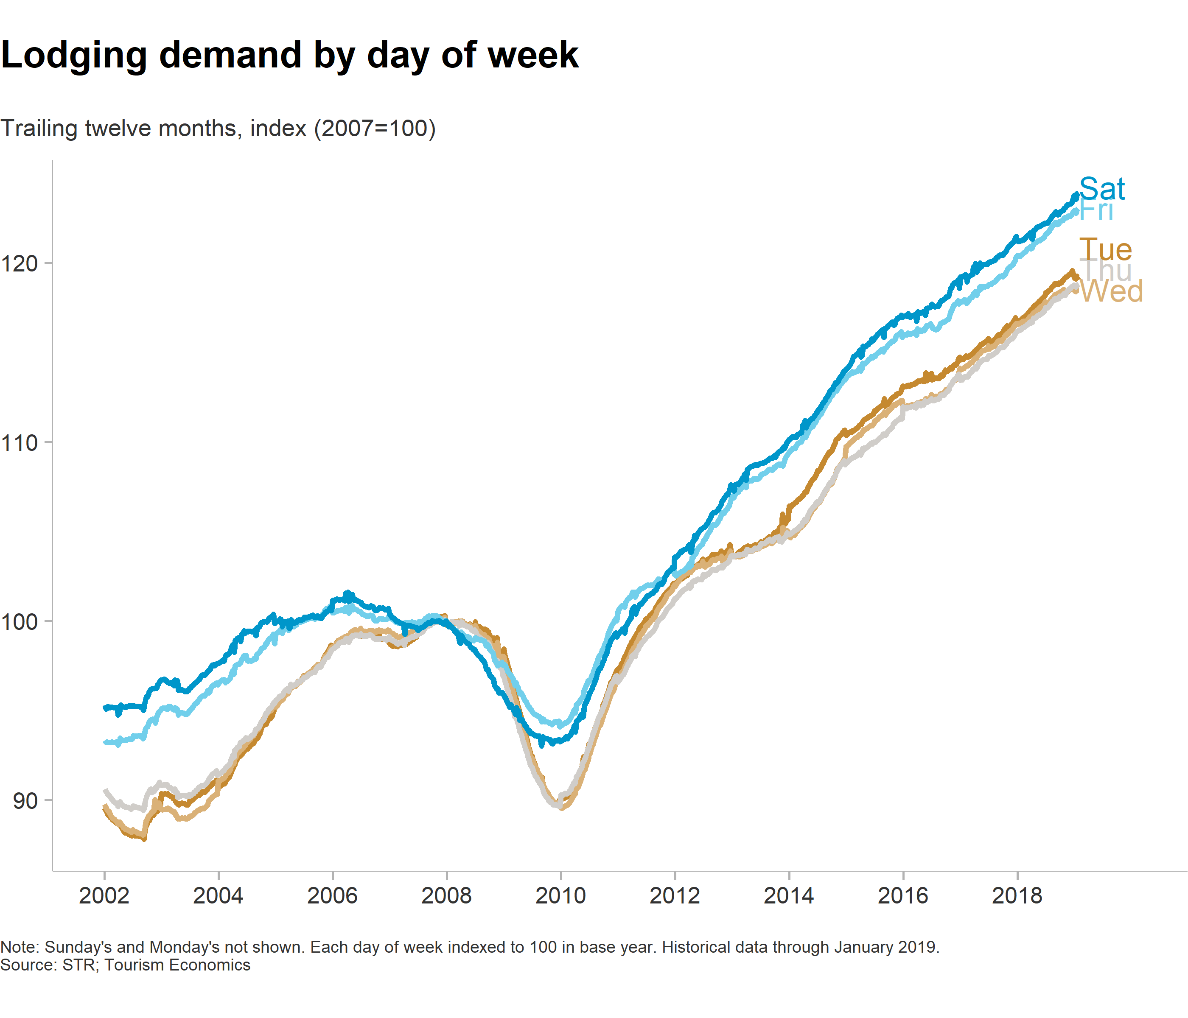
Weekends rule

Slide 13
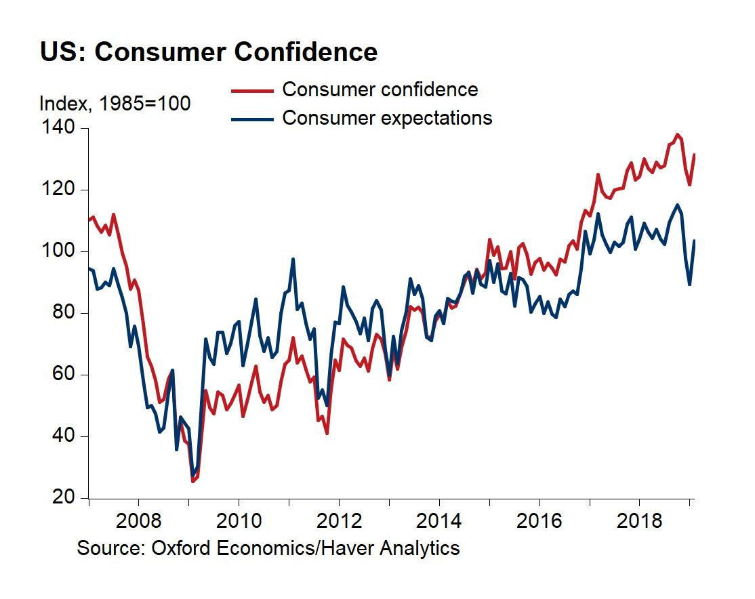
Consumer confidence remains strong
Government shutdown

Slide 14
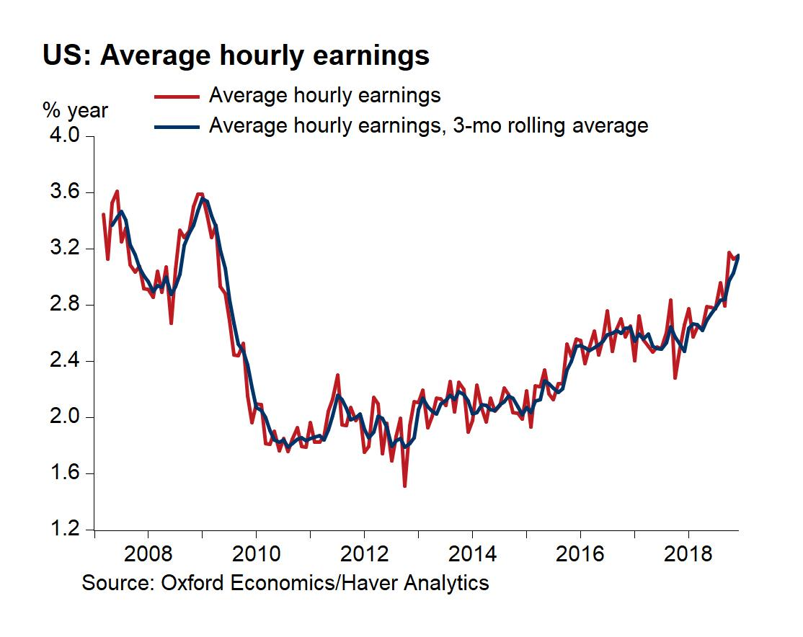
Wage growth is firming “gradually”

Slide 15
Where are we headed?
Notes:
15

Slide 16
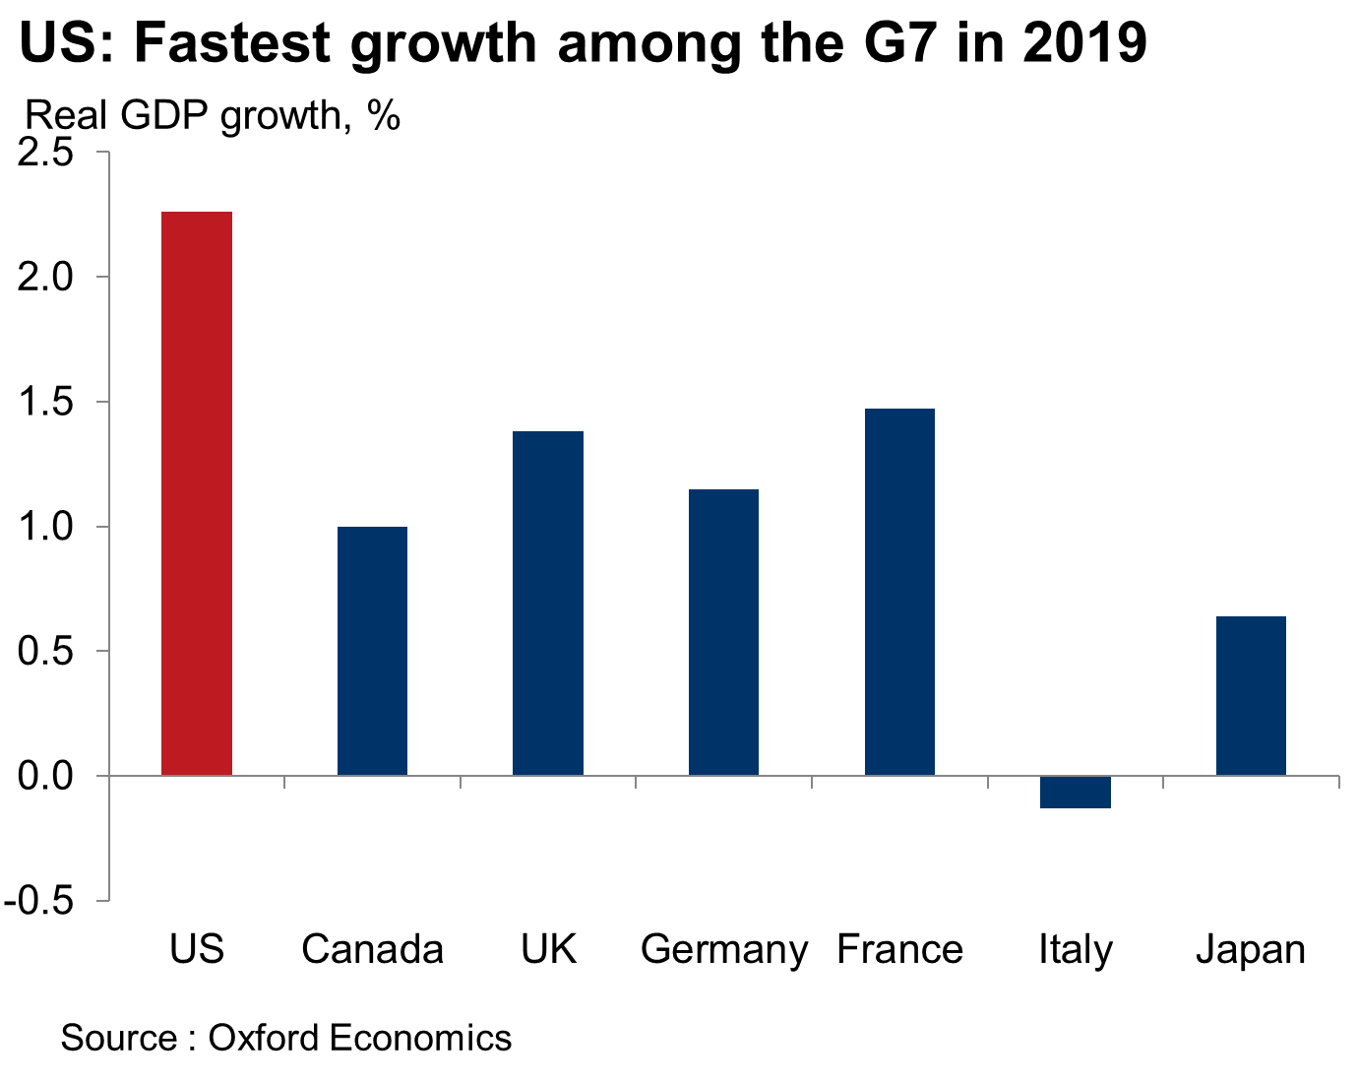
US will be fastest G-7 economy in 2019… by wide margin!

Slide 17
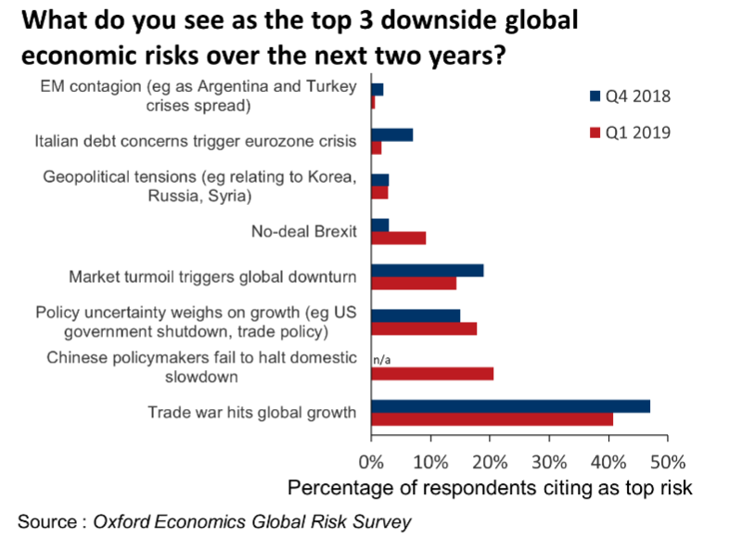
Trade war still seen as #1 risk followed by China, policy, markets

Slide 18
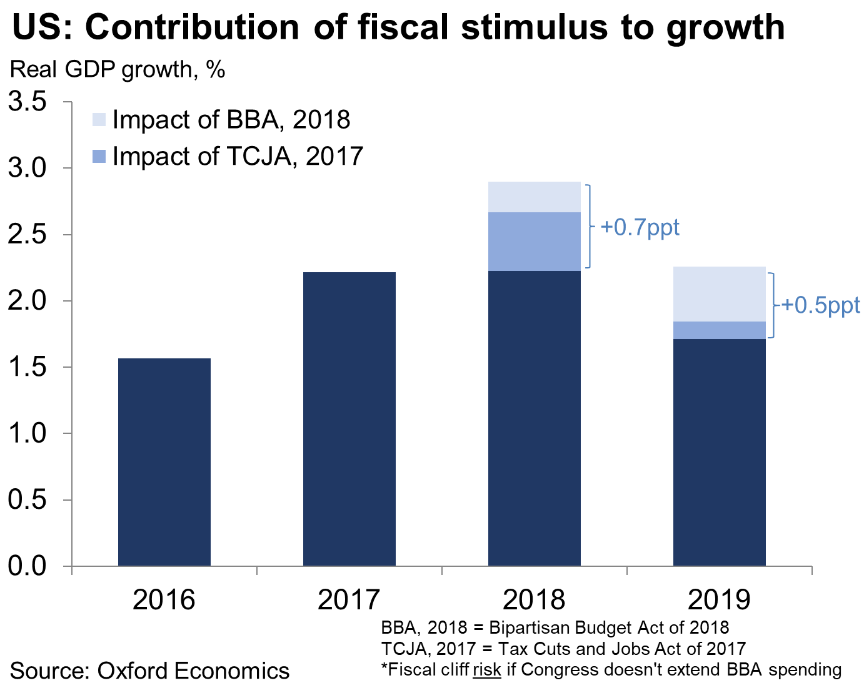
Tax cuts & government spending boost is subsiding

Slide 19
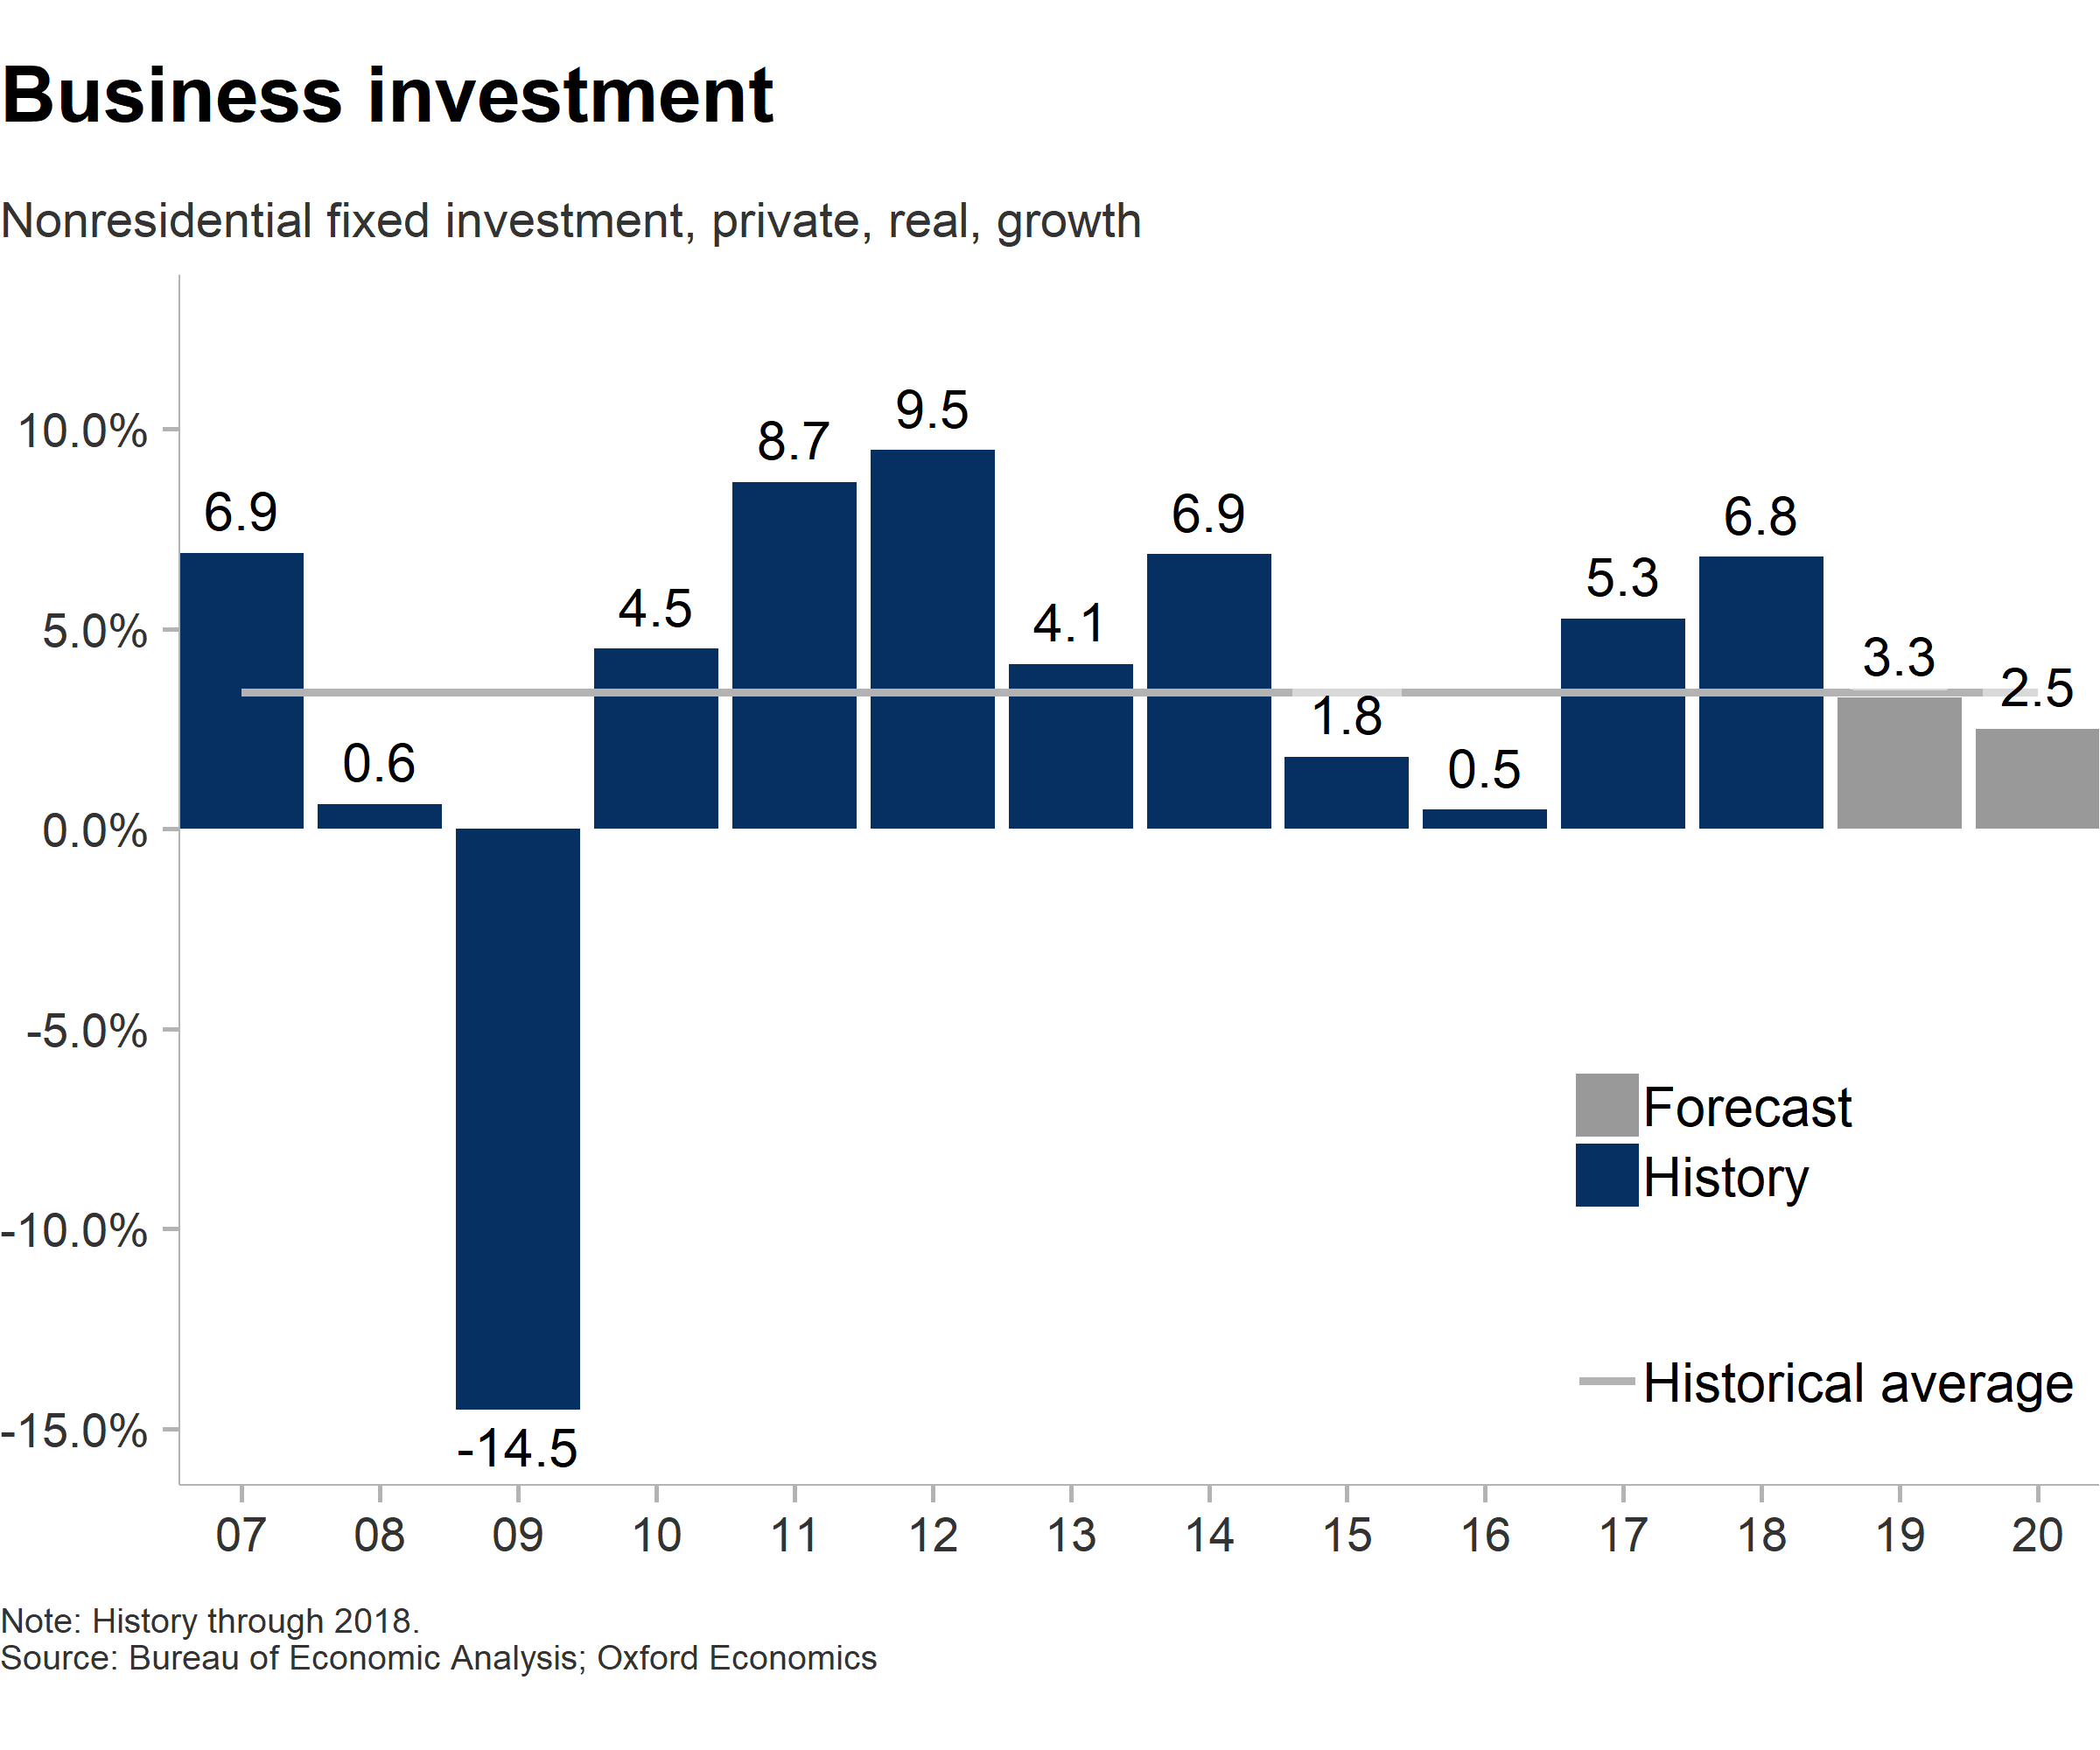
Business investment poised to cool
Domestic demand → moderating
Tax incentives & deregulation → diminishing boost
Financial conditions → tightening
Global growth → slowing

Slide 20
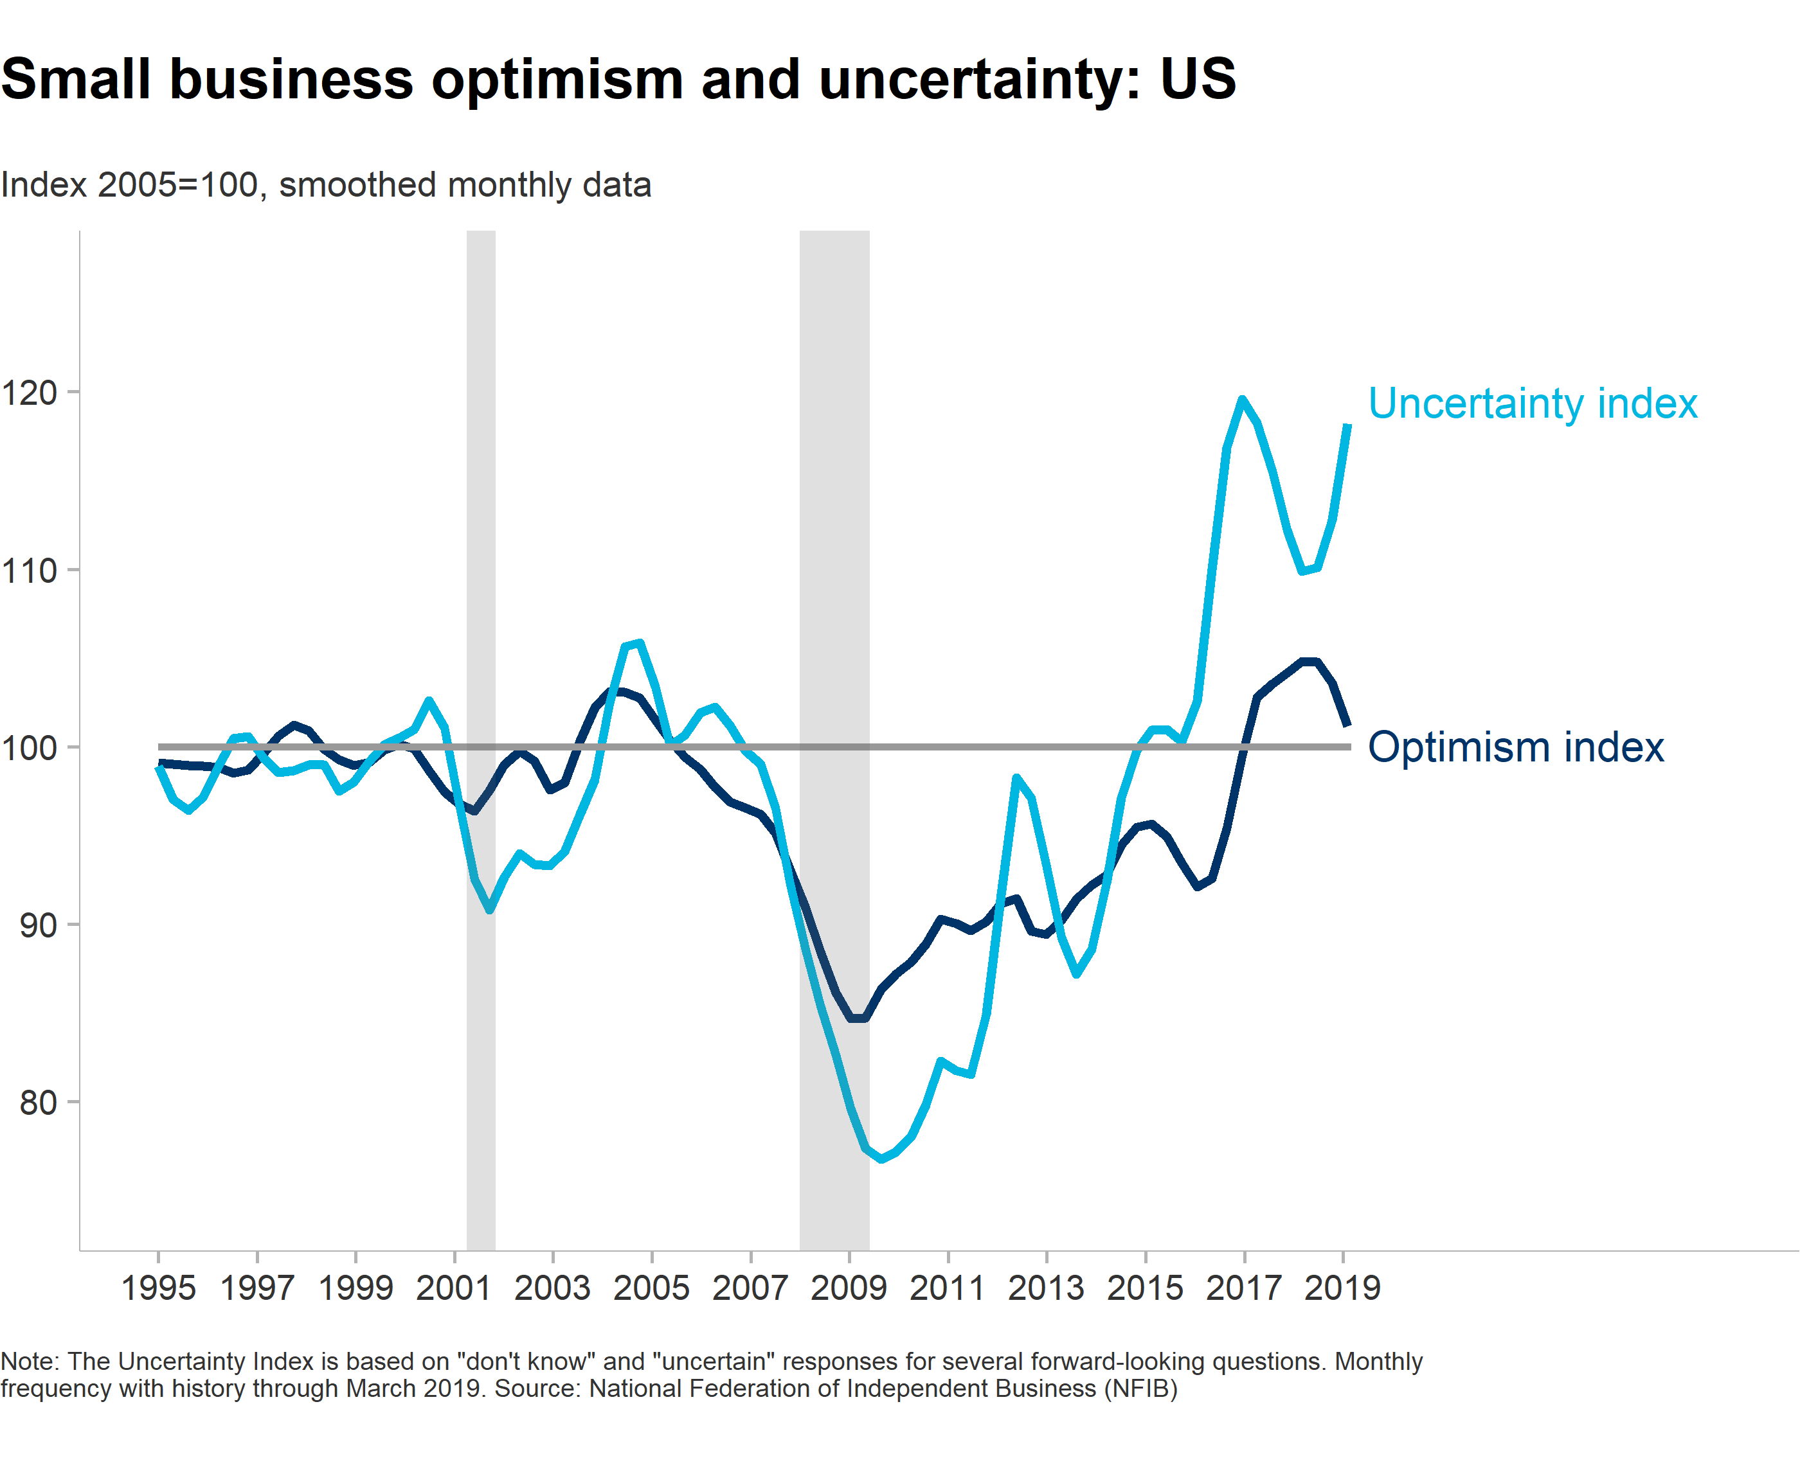
Business confidence still high, but off its highs

Slide 21
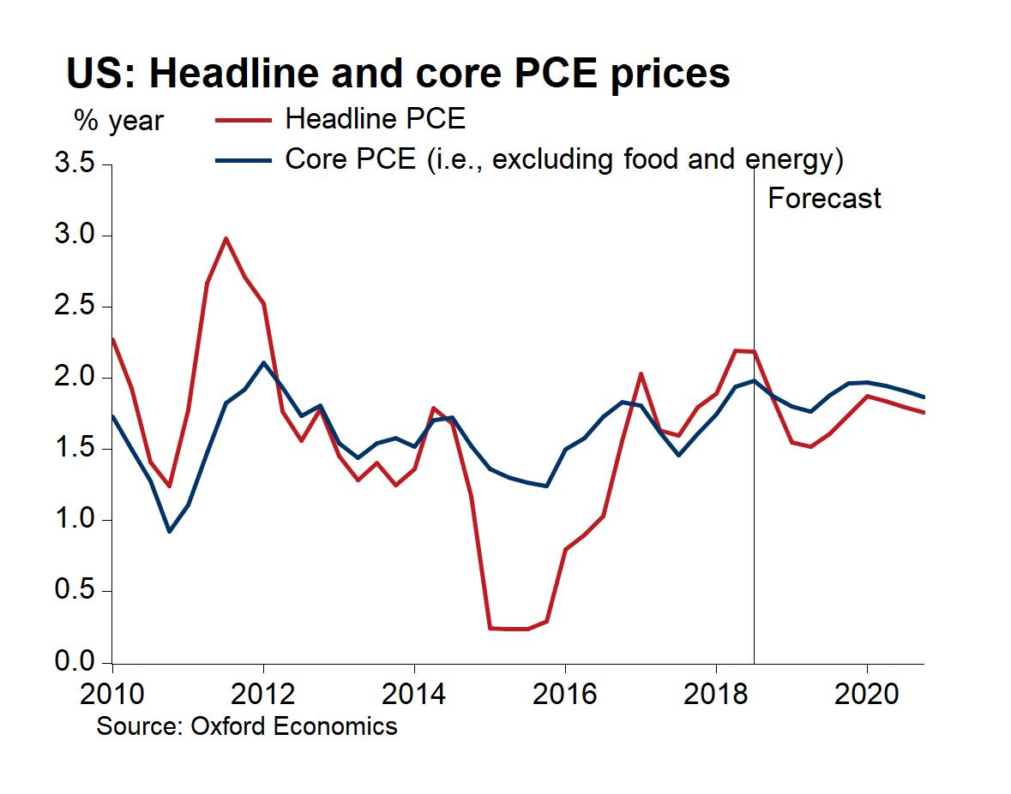
Headline inflation below 2%, while core at Fed target

Slide 22
Leading travel indicators: cautionary but not alarming

Slide 23
Air travel bookings remain steady

Slide 24
And vacation intentions are on the upswing

Slide 25
But the slowdown is underway

Slide 26
What SHOULD be Done?
Notes:
26

Slide 27
Hotel demand is setting new norms (and trending upward)

Slide 28
Travel continues to gain American wallet share

Slide 29
Hospitality has led total job growth in 95 of the top 100 US cities
$3.5 billion in KC visitor spending
48,000 jobs
Tax generation saves KC households $550 a year

Slide 30
Cabarrus County is leading NC employment growth

Slide 31
Visitor economy is driving employment growth

Slide 32
Visitor economy income is driving local economy

Slide 33
The need for destination promotion
 | Challenge | Solution: Destination Promotion
1 | The primary motivator of a trip is usually the experience of a destination, not just one business | Articulates the brand message that is consistent with consumer motivations
2 | Effective marketing requires scale to reach potential visitors | Pools sustained resources to provide the economies of scale and marketing infrastructure required to generate impact
Notes:
Global&US.PPT
Linked:
D:\DATA\PMI\PMI_Data_Charts ‘Manufacturing US, EZ,JAP,UK’

Slide 34
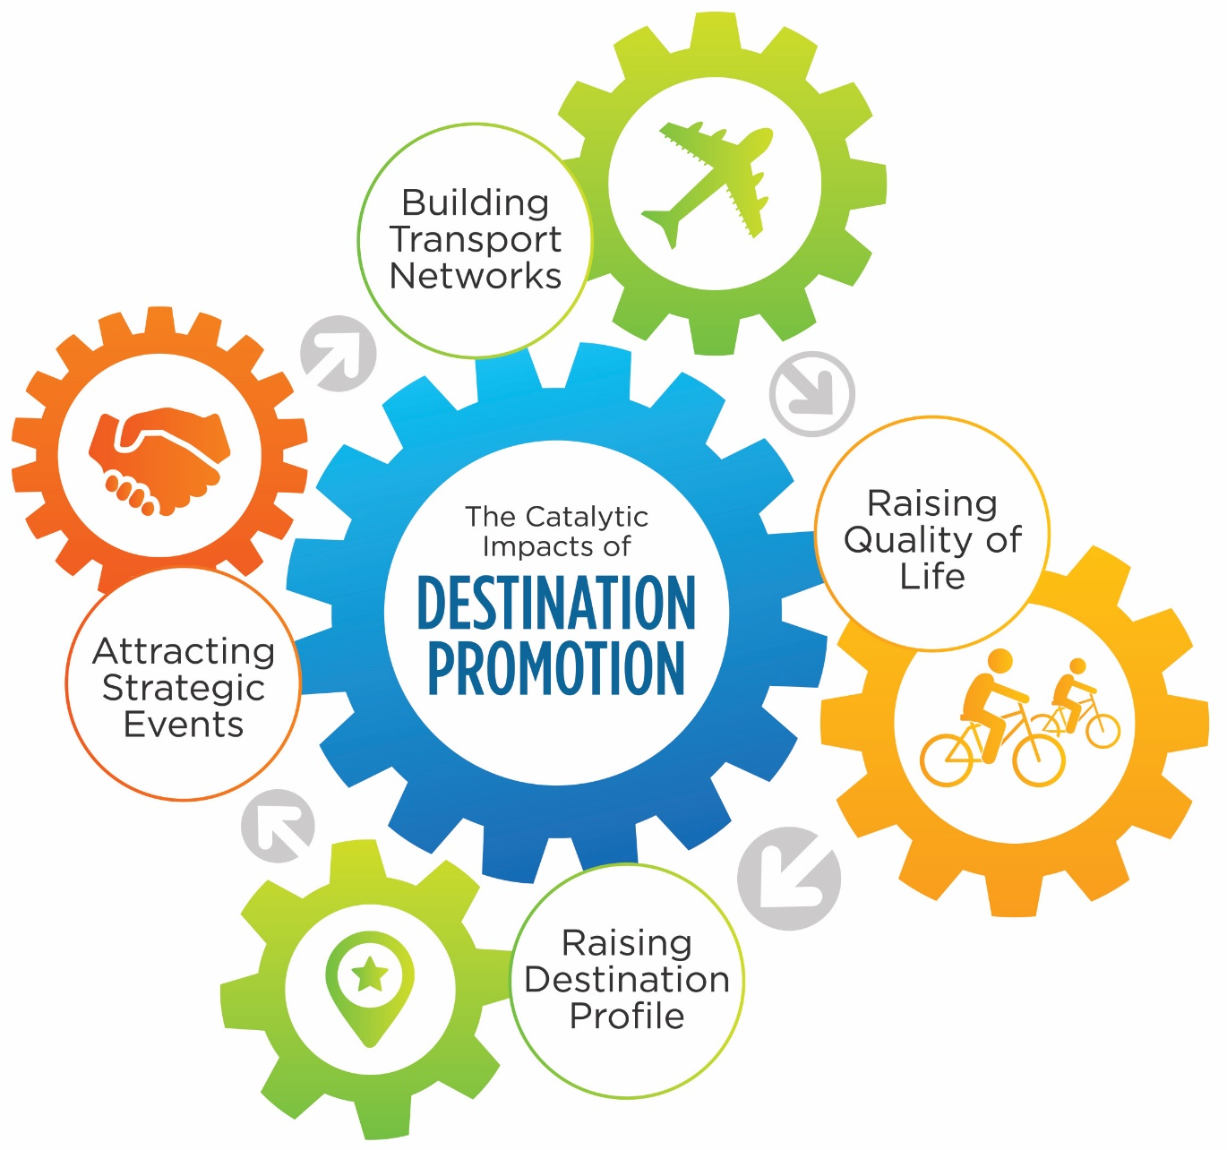
The “catalytic” role of destination marketing

Slide 35
In the words of economic development heads
“Air service is profoundly important to corporate investment and location decisions… This is one of tourism’s most significant contributions since the levels of air service at New Orleans far exceed what local demand could support.”
Secretary, Louisiana Economic Development
“Every tourist that comes through here is a potential business lead.”
President & CEO, World Business Chicago
“As we talk to prospects, they mention past visits and good experiences. This is our open door”
Executive Director, Economic Development Coalition for Asheville
“If we do it right, the ideal brand will transcend the visitor market and support all economic development.”
Economic Development Executive Officer, City of Phoenix
“We are learning a lot from Visit California … how to take their model and apply it to economic development.”
Deputy Director, Governor’s Office of Business and Economic Development
“Traveler attractions are the same reason that CEOs choose a place.”
President & CEO, World Business Chicago

Slide 36
Summary
Trends | Expectations | Mandate
2018 was a solid year US economic fundamentals driving domestic market International market faltering | US economy is on a slowing track Recession indicators are not flashing Continued travel growth expected in both group and leisure markets | Destination marketing is critical to economic development Competitiveness requires concerted branding, marketing, and sales

Slide 37
Performance and Prospects for Travel
Adam Sacks
President
Tourism Economics
adam@tourismeconomics.com
May 2019

